Slide 1

ACM INDIA SUMMER SCHOOL
IoT Simulators

Slide 2
What are Simulators?
Physical Systems(Sensors/Actuators)
Communication(Socket APIs)
Virtual Systems
Run Simulation
Performance Analysis(Graph etc)
A device that enables the operator to reproduce or represent under test conditions phenomena likely to occur in actual performance.
Types Of Simulators
Network Simulators : Used to simulate a specific layer or all of them present in network stack.
Example: COOJA , NS3 etc
Physical Simulators : Used to simulate physical(hardwares) like vehicles and drones.
Example: GAZEBO etc
Simulators Vs Emulators
Simulators are used to simulate the hardwares in a virtual environment.
Emulators work on a physical setup. Example- Mininet/Maxinet

Slide 3
Why to use Simulators?
Network connection plays a vital role as IoT is all about the data being communicated in faster speeds all the time. IoT architecture has to be tested in all kinds of network connectivity/speeds. To test this, virtual network simulators are mostly used to vary the network load, connectivity, stability etc.
Application Layer
Transport Layer
Network Layer
Data Link Layer
Physical Layer
To test the desired protocol(https/coap/mqtt/websocket)
Reassembly of the data segment TCP/UDP
To monitor the packets dropped/received(IPv4/IPv6)
Error detection (CRC, CSMA CA/CD)
To monitor the data rate or the radio transmission (Zigbee/Wi-Max etc)

Slide 4
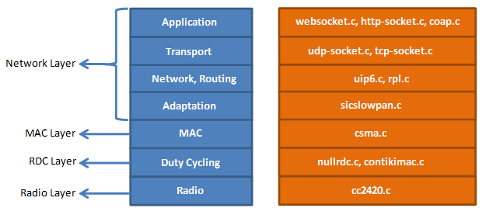
When to choose what? (Cooja/NS3/MiniNet)
Contiki plays the best role when working with power constrained networks.
Eg- 802.15.4
Best to be used with Zolertia motes, TelosB
RPL knowledge is necessary
Knowledge Of C is must
NS3 is suitable to test almost all real time network usage eg- Wi-Fi, LTE, FANET etc
Can be used for Drone/V2x simulation
Network /Link Performance Analysis is easy
Knowledge Of C++ and Python is must
MiniNet acts as an emulator for SDN networks
Supports
The Mininet-WiFi developers extended the functionality of Mininet by adding virtualized WiFi stations and access points based on the standard Linux wireless drivers and the 80211_hwsim wireless simulation driver.

Slide 5
Network Simulator (NS3)
Ns3 is a discrete event network simulator. It provides a simulation time and it jump from one event to another event. Ns3 contains various inbuilt libraries and modules within a directory. It supports Graphical user interface and python bindings.
Model Development
Develop by a Defined Channel and Mobility Models
Simulate a Model according to Events
Node and also Link Configuration
Define Node and Link Attributes (Data rate, Latency and also Packet Loss)
Manage Command Arguments
Simulation Execution
Building a File and also Analyze Outputs in a Command Prompt
Performance Analysis
Modeling Network by using NetAnim
Analyze the Performance under GNU plot
ns-3 | a discrete-event network simulator for internet systems (nsnam.org)

Slide 6
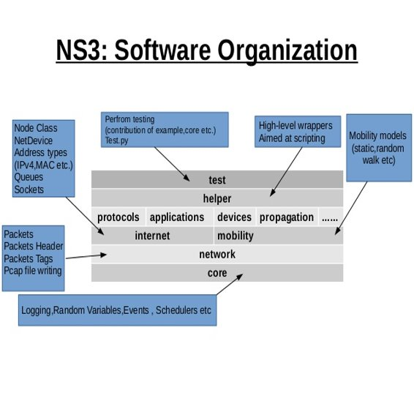
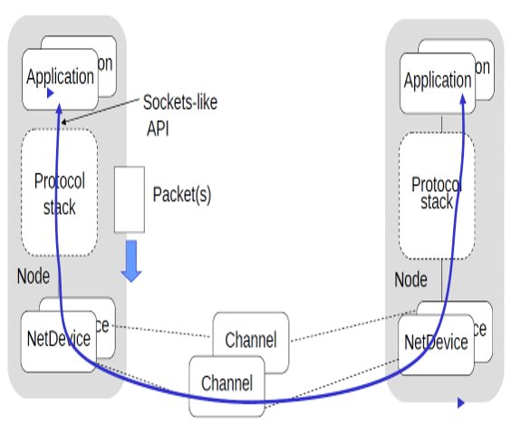
How Does NS3 Work?

Slide 7

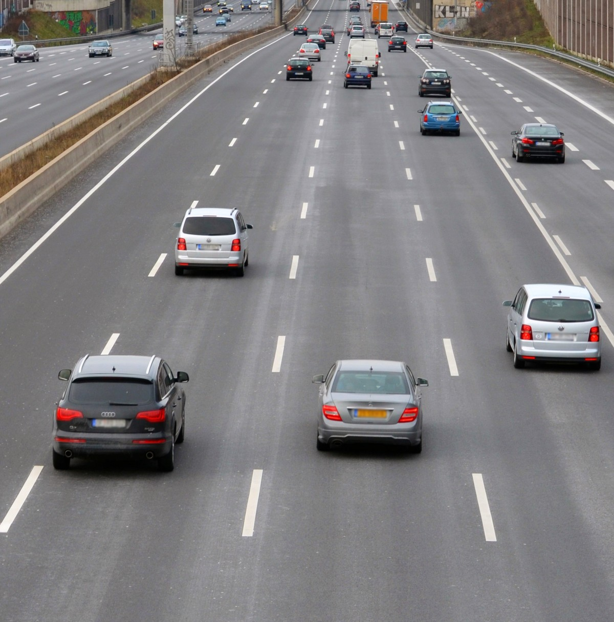
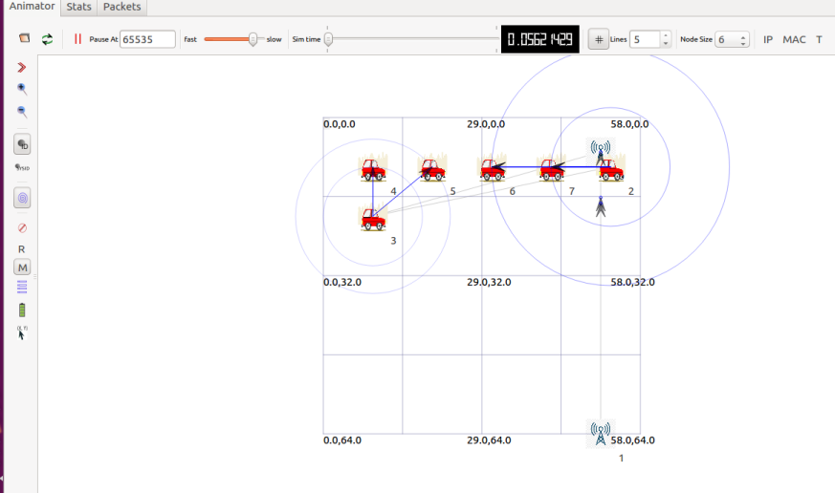
NS3 for LTE Simulation : V2X Usecase
LTE 4G Tower
NS3
LTE 4G Tower
Traffic Scenario with V2X (Vehicles to LTE towers) communication

Slide 8
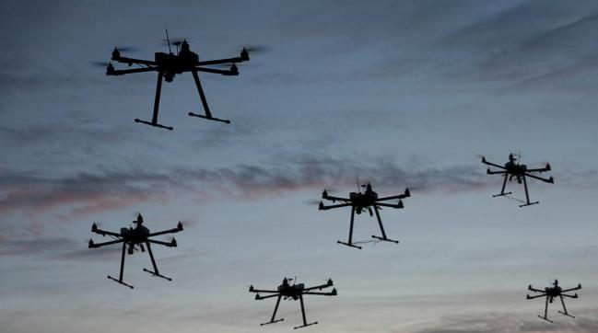
Multi-drone systems
Multiple drones cooperate and communicate with each other.
Single drone is far less capable as an entity.
Applications
military missions (battlefield surveillance)
searching for survivors in disaster hit areas
delivery of payload
drone light shows
smart city, etc.
Complexity lies in the co-ordinated movement.

Slide 9
Why do we need simulators for UAV?
UAV fleet deployment in a city for package delivery
Resource requirements for experiments
UAVs
Network devices
Flight controllers
Operational constraints
Access to target environments
Scalability challenges
Devices may not be available in specific quantities
Safe risk compared to hardware failure
Confidence gain for system's behaviour
Precise evaluation of UAV's mobility
Simulation environments: ROS, AirSim, Gazebo, MATLAB

Slide 10
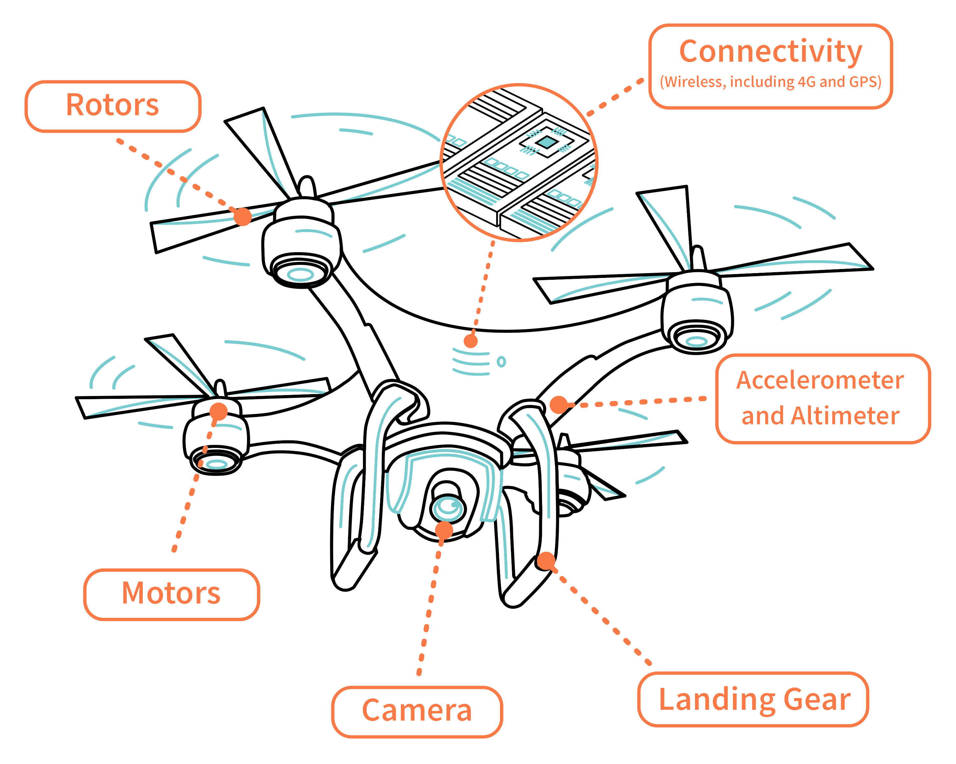
Components in an UAV simulation
Physical design
Sensors
Actuators
Battery
Controllers
Communication/Networking
Onboard compute
https://www.ctia.org/news/up-up-and-away-how-do-drones-work
Notes:
The frame is the bearing structure of a drone. It has to be light and robust in order to resist to impacts and stress. It is often made of plastic or carbon fiber and has an X shape (Quad-X configuration) or an + shape (Quad-+ configuration)
The brushless motors turn the propellers, supporting the drone and keeping it in flight
The ESC (Electronic Speed Controls) change the rotation speed of the electric motor and control its rotation direction by varying the supply voltage supplied by the battery. Each engine has a dedicated ESC.
The propellers can be made in plastic or carbon fiber and they has to be as light and robust as frame
The LiPo battery is the primary source of energy, his capacity determines the flight autonomy and the maximum power developed by the engines.
The controller acquires sensors data and, after an elaboration with a dedicated processor, controls the rotational speed of motors through the ESCs. The main sensors on a drone are IMU (Inertial Measurement Unit), that measure angular accellarion and speed, gyroscope, GPS and altimeter.

Slide 11
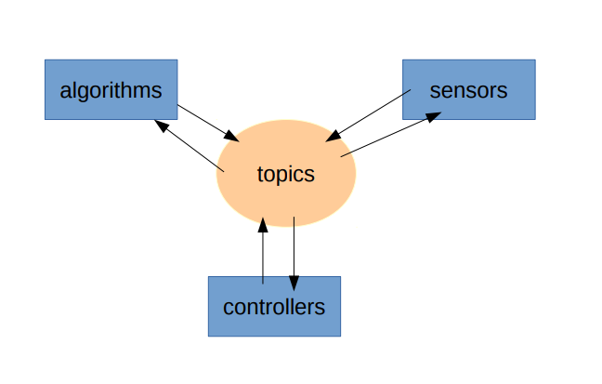
Robot Operating System (ROS)
Open-source meta-operating system
Hardware abstraction
Low level device control
Inter-process communication
Flexible framework for writing robot software.
Collection of tools, libraries, and conventions
https://www.ros.org/about-ros/
Notes:
open-source meta-operating system for your robot. It provides the services you would expect from an operating system, including hardware abstraction, low-level device control, implementation of commonly-used functionality, message-passing between processes, and package management.

Slide 12
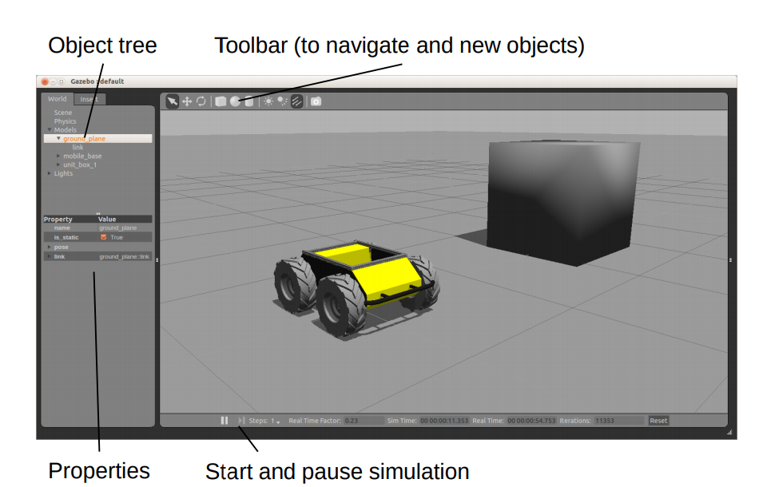
Gazebo simulator
3d rigid-body dynamics
variety of sensors including noise
3d visualization and user interaction
Includes a database of many robots and environments (Gazebo worlds)
Provides a ROS interface
Extensible with plugins
Simulation tool already installed in ROS
http://gazebosim.org/
http://gazebosim.org/tutorials

Slide 13
Case: Drone flies to waypoint: Workflow
ROS
Drone Structure (URDF)
Gazebo Client (GUI)
Gazebo Server
Odometry sensor
Motors
Position Controller
Gazebo
World with Obstacles
Waypoint subscriber
Waypoint publisher
Hardware Integration using Drivers
Coordination Scripts

Slide 14
DEMO

